Slide 1
Object Oriented Programming (Introduction to Programming) Manuel Mazzara
Organizational Information

Slide 2
Mock and final exam
Mock exam is today
Will not be graded
Final exam on 8.12.2016 at 9am
In several rooms, you will be informed
Do not forget office hours, also for feedback on mock exam!

Slide 3
Object Oriented Programming (Introduction to Programming) Manuel Mazzara
Lecture 15: Axiomatic semantics

Slide 4
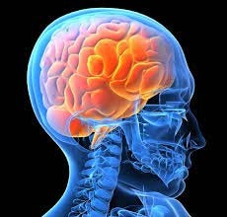



For this last lecture…
Minds open…
… Laptops closed!

Slide 5
Axiomatic semantics
Floyd (1967), Hoare (1969), Dijkstra (1978)
Purpose:
Describe the effect of programs through a theory of the underlying programming language, allowing proofs

Slide 6
What is a theory?
(Think of any mathematical example, e.g. elementary arithmetic)
A theory is a mathematical framework for proving properties about a certain object domain
Such properties are called theorems
Components of a theory:
Grammar (e.g. BNF), defines well‐formed formulae (WFF)
Axioms: formulae asserted to be theorems
Inference rules: ways to prove new theorems from previously
obtained theorems

Slide 7
Notation
Let f be a well‐formed formula
Then
⊢ f
expresses that f is a theorem

Slide 8
Inference rule
An inference rule is written
f₁, f₂, …, f_{n}
It expresses that if f₁, f₂, … f_{n} are theorems, we may infer f₀ as another theorem
f₀

Slide 9
Example inference rule
“Modus Ponens” (common to many theories):
p, p ⇒ q
q
See also “ Modus tollens ”

Slide 10
How to obtain theorems
Theorems are obtained from the axioms by zero or more* applications of the inference rules.
*Finite of course. Why? You may want to be able to compute in your lifetime.

Slide 11
Example: a simple theory of integers (1)
Grammar: Well‐Formed Formulae are boolean expressions
i1 = i2
i1 < i2
¬ b1
b1 ⇒ b2
where b1 and b2 are boolean expressions, i1 and i2 integer expressions

Slide 12
Example: a simple theory of integers (2)
An integer expression is one of
0
a variable n
f’ where f is an integer expression
(represents “successor”)

Slide 13
An axiom and axiom schema
⊢ 0 < 0’
⊢ f < g ⇒ f’ < g’

Slide 14
An inference rule
P (0), P (f) ⇒ P (f’)
P (f)
This is mathematical induction and theory of number is formulated in Peano’s axioms

Slide 15
Hoare triple
Grammar: a well‐formed formula is a “Hoare triple”
{P} A {Q}
Instructions
Informal meaning: A, started in any state satisfying P, will satisfy Q on termination
Assertion
Assertion

Slide 16
Partial vs total correctness
{P} A {Q}
Total correctness:
A, started in any state satisfying P, will terminate in a state satisfying Q
Partial correctness:
A, started in any state satisfying P, will, if it terminates, yield a state satisfying Q

Slide 17
Axiomatic semantics
“Hoare semantics” or “Hoare logic”: a theory describing the partial correctness of programs, plus termination rules

Slide 18
What is an assertion?
Predicate (boolean‐valued function) on the set of computation states
s
T F
State
True means the function that yields T for all states
False means the function that yields F for all states
P implies Q means ∀ s : State, P (s ) ⇒ Q (s ) and so on for other boolean operators

Slide 19
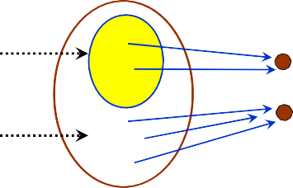

What is an assertion? An equivalent view
We may also view an assertion P as a subset of the set of states: the subset where the assertion yields T
P
s
T F
not P
State
True means the full State set
False means the empty subset
P implies Q means P ⊆ Q
and: intersection or: union

Slide 20
The case of postconditions
Postconditions are often predicates on two states
Example (Eiffel, in a class COUNTER):
increment
require
count >= 0
…
ensure
count = old count + 1

Slide 21
Elementary mathematics
Assume we want to prove, on integers
{x > 0} A {y >= 0}
but have actually proved
{x > 0} A {y = z ^ 2}
We need properties from other theories, e.g. arithmetic

Slide 22
“EM”: Elementary Mathematics
The mark [EM] will denote results from other theories, taken for brevity (in this discussion) without proof
Example:
y = z ^ 2 implies y >= 0
[EM]

Slide 23
Rule of consequence
{P} A {Q}, P’ implies P, Q implies Q’
{P’} A {Q’}

Slide 24
Rule of conjunction
{P} A {Q}, {P} A {Q’}
{P} A {Q and Q‘}

Slide 25
Axiomatic semantics for a programming language
Example language: Graal (from Introduction to the theory of Programming Languages by Bertrand Meyer)
Objective: give an axiom or inference rule for every language construct

Slide 26
Skip
{P} skip {P}
“Leaving things as they are”

Slide 27
Abort
{False} abort {P}
It cannot “leave things as they are”. Like a non-terminating loop. It is impossible to prove anything interesting, this is what the rules express. Irrelevant to the theory.

Slide 28
Sequential composition
{P} A {Q}, {Q} B {R}
{P} A ; B {R}

Slide 29
Assignment axiom (schema)
{P [e / x]}
x := e {P}
P [e/x] is the expression obtained from P by replacing (substituting) every occurrence of x by e.

Slide 30
Applying the assignment axiom
{ y > z –2 }
x := x + 1
{y > z – 2}
{2 + 2 = 5}
x := x + 1
{2 + 2 = 5}
{y > 0}
x := y
{x > 0}
{ x + 1 > 0 }
x := x + 1
{x > 0}

Slide 31
Conditional rule
{P and c} A {Q}, {P and not c} B {Q}
{P} if c then A else B end {Q}

Slide 32
Loop rule (partial correctness)
{P} A {I},
{I and not c} B {I}
{P} from A until c loop B end {I and c}

Slide 33
Slight variant
{P} A {I},
{I and not c} B {I} , (I and c) implies Q
{P}from A until c loop B end {Q}

Slide 34
Loop termination
Must show there is a variant:
Expression v of type INTEGER such that
(for a loop from A until c loop B end with precondition P):
1. {P} A {v ≥ 0}
2. ∀ v0 ≥ 0:
{v = v0 and not c} B {v < v0 and v ≥ 0}

Slide 35
Loops as problem‐solving strategy
A loop invariant is a property that:
Is easy to establish initially
(even to cover a trivial part of the data)
Is easy to extend to cover a bigger part
If covering all data, gives the desired result!

Slide 36
Computing the maximum of an array
from
i := 0 ; Result := a [1]
until
i = a.upper
loop
i := i + 1
Result := max (Result , a [i ])
end

Slide 37
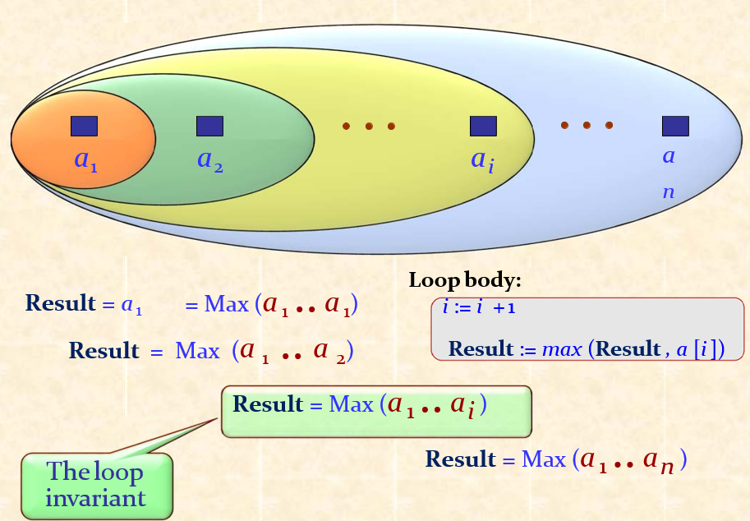
Loop as approximation strategy

Slide 38
Routines (1)
For:
f (x: T) do Body end
{P} Body {Q}
{P [a/x]} f (a) {Q [a/x]}

Slide 39
Routines (2)
For:
f (x: T) do Body end
(∀ a | {P [a/x]} f (a) {Q [a/x]} ) implies {P} Body {Q}
{P [a/x]} f (a) {Q [a/x]}

Slide 40
Soundness and completeness
How do we know that an axiomatic semantics (or logic) is “right”?
Sound: every deduced property holds of all corresponding program executions
Complete: every property that holds of all program executions can be proved by the logic
(Undecidable!)

